Slide 1
AI-GIS BASED MOBILE APPLICATION FOR
TRACKING DEEP SEA FISHERMEN
A.V.C. COLLEGE OF ENGINEERING
DEPARTMENT OF ELECTRONICS AND COMMUNICATION ENGINEERING
Presented by
S. Sivapriya (820320106022)
G. Udhaya (820320106026)
S. Vishwaja (820320106029)
GUIDE NAME: Dr. C. Jayasri., M. Tech, Ph.D (Assistant Professor)

Slide 2
Abstract
A technology for real-time tracking in low-connectivity deep-sea environments is crucial for enhancing the safety of fishermen. This project aims to address this challenge by creating an AI-based Geographic Information System (GIS) app.
Leveraging advanced algorithms, the app will accurately detect and track deep-sea fishermen's locations during maritime activities.
With a user-friendly interface, the app will provide comprehensive monitoring, ensuring safety in remote and challenging environments.
The anticipated outcome is an innovative GIS app that significantly improves tracking capabilities, contributing to enhanced safety measures and efficient maritime activities, thus positively impacting the well-being of deep-sea fishermen.

Slide 3
Objectives
An AI-based Geographic Information System (GIS) application specifically tailored for detecting and tracking the locations of fishermen engaged in deep-sea fishing activities. By leveraging advanced artificial intelligence and machine learning algorithms, the app aims to accurately pinpoint the real-time whereabouts of fishermen operating in remote and low-connectivity deep-sea environments.
The goal of project the is to enhance safety measures for fishermen by providing timely and reliable location information, thereby mitigating risks associated with maritime activities in challenging oceanic conditions.

Slide 4

Introduction
Deep-sea fishing is a vital industry contributing to global food supply and economic prosperity, yet it poses significant challenges due to the remote and unpredictable nature of the marine environment. One of the foremost concerns in deep-sea fishing is ensuring the safety and well-being of fishermen who navigate these treacherous waters.
Despite advances in maritime technology, the lack of reliable and continuous communication infrastructure in deep-sea locations presents a formidable barrier to establishing effective real-time tracking systems for fishermen.
Recognizing the critical need to address this safety gap, our project endeavors to develop an innovative AI-based Geographic Information System (GIS) application tailored specifically for detecting fishermen's locations during deep-sea fishing activities.

Slide 5
Existing System
LiFi-based fishermen tracking system using GPS incorporates visible light communication (VLC) technology to enhance the accuracy and reliability of tracking fishermen in maritime environments.
Additionally, LiFi technology provides inherent advantages such as increased security, immunity to electromagnetic interference, and reduced latency, making it an ideal solution for enhancing the efficiency and safety of maritime operations.
Disadvantages:
Limited Coverage Area
Weather Dependence
Interference from Obstructions
High Implementation Cost
Compatibility with Existing Infrastructure

Slide 6


Proposed System
An AI-based Geographic Information System (GIS) application specifically tailored for detecting and tracking the locations of fishermen engaged in deep-sea fishing activities. Leveraging advanced artificial intelligence and machine learning algorithms, the app will analyze relevant data such as GPS coordinates, environmental conditions, and vessel movements to provide real-time location information.
This innovative solution will offer a comprehensive and user-friendly interface for effective monitoring, ensuring the safety of fishermen operating in remote and challenging deep-sea environments. By improving tracking capabilities and enhancing safety measures, the proposed system aims to contribute to the efficiency and well-being of deep-sea fishermen while addressing critical aspects of maritime safety.

Slide 7
Advantages
Enhanced safety through monitoring.
Accurate real-time location tracking.
User-friendly interface for monitoring.
Effective utilization of AI.
Improved efficiency and well-being.

Slide 8
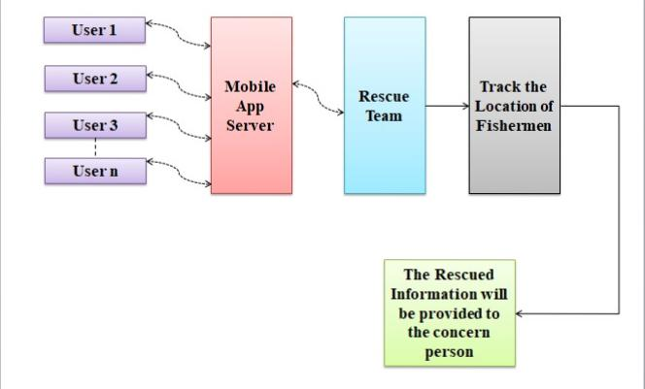
Block Diagram

Slide 9
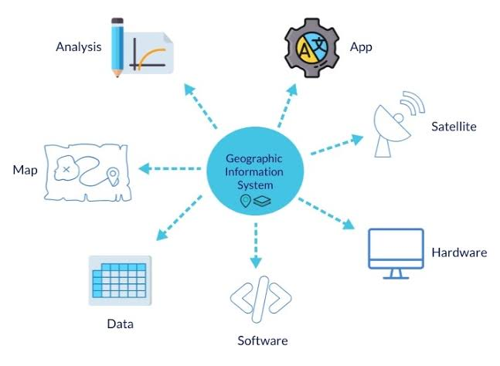
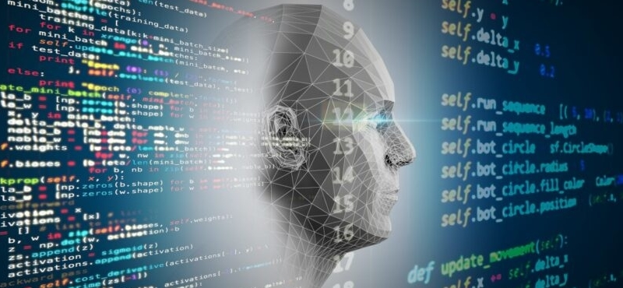
Modules Description
Geographic Information System (GIS) Application Development Module
Safety Enhancement and Impact Assessment Module
AI Algorithm Development Module
Low-Connectivity Technology Development Module
Communication Infrastructure Assessment Module

Slide 10
System Requirement
HARDWARE REQUIREMENTS
Processors: Intel® Core™ i5 processor 4300M at 2.60 GHz or 2.59 GHz (1 socket, 2 cores, 2 threads per core), 8 GB of DRAM
Disk space: 320 GB
Operating systems: Windows® 10
SOFTWARE REQUIREMENTS
Server Side : Android studio
Client Side : HTML, CSS, Bootstrap
IDE : Flask 1.1.1
Back end : MySQL 5.
Server : WampServer 2i
OS : Windows 10 64 –bit

Slide 11
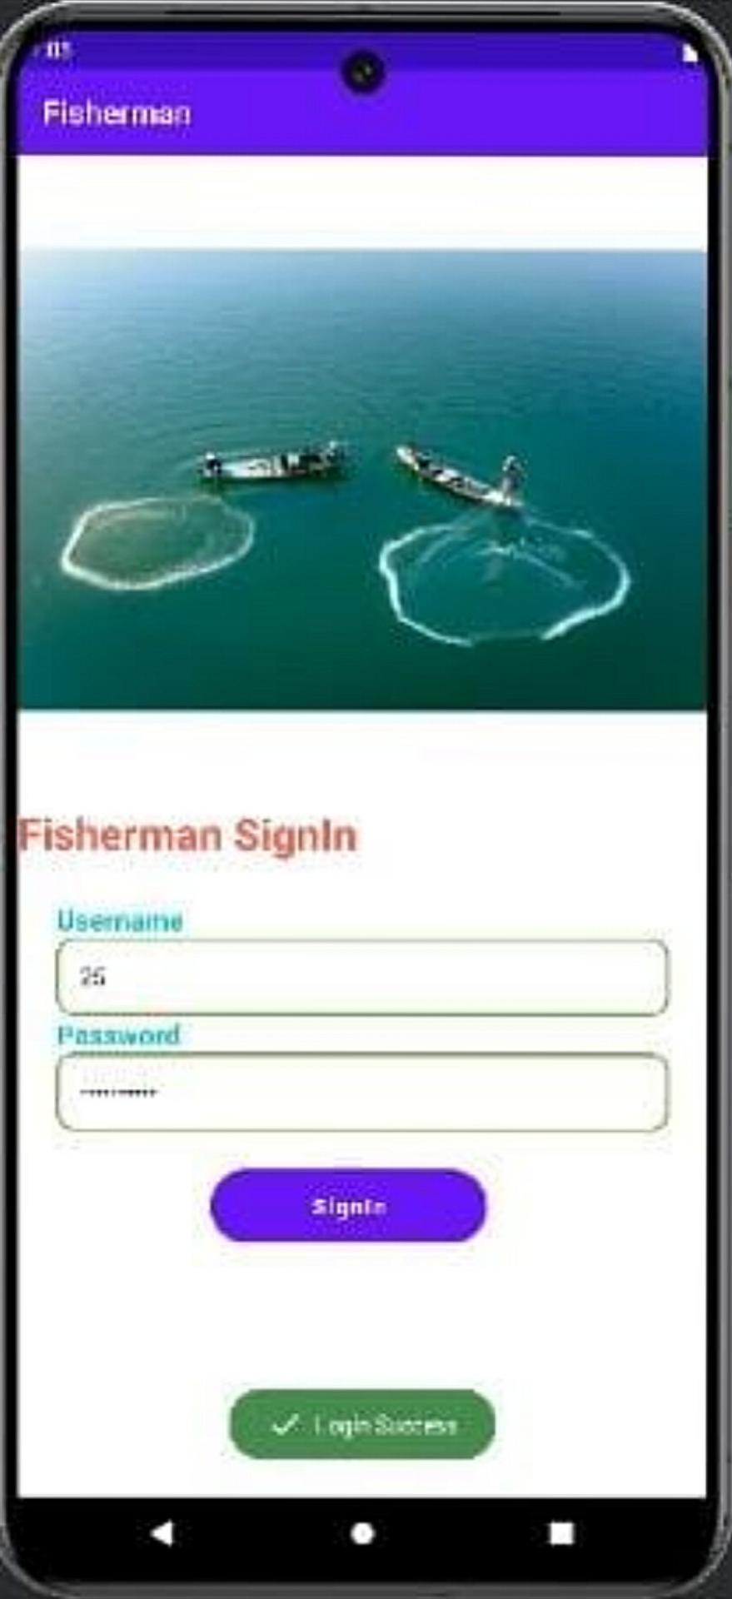
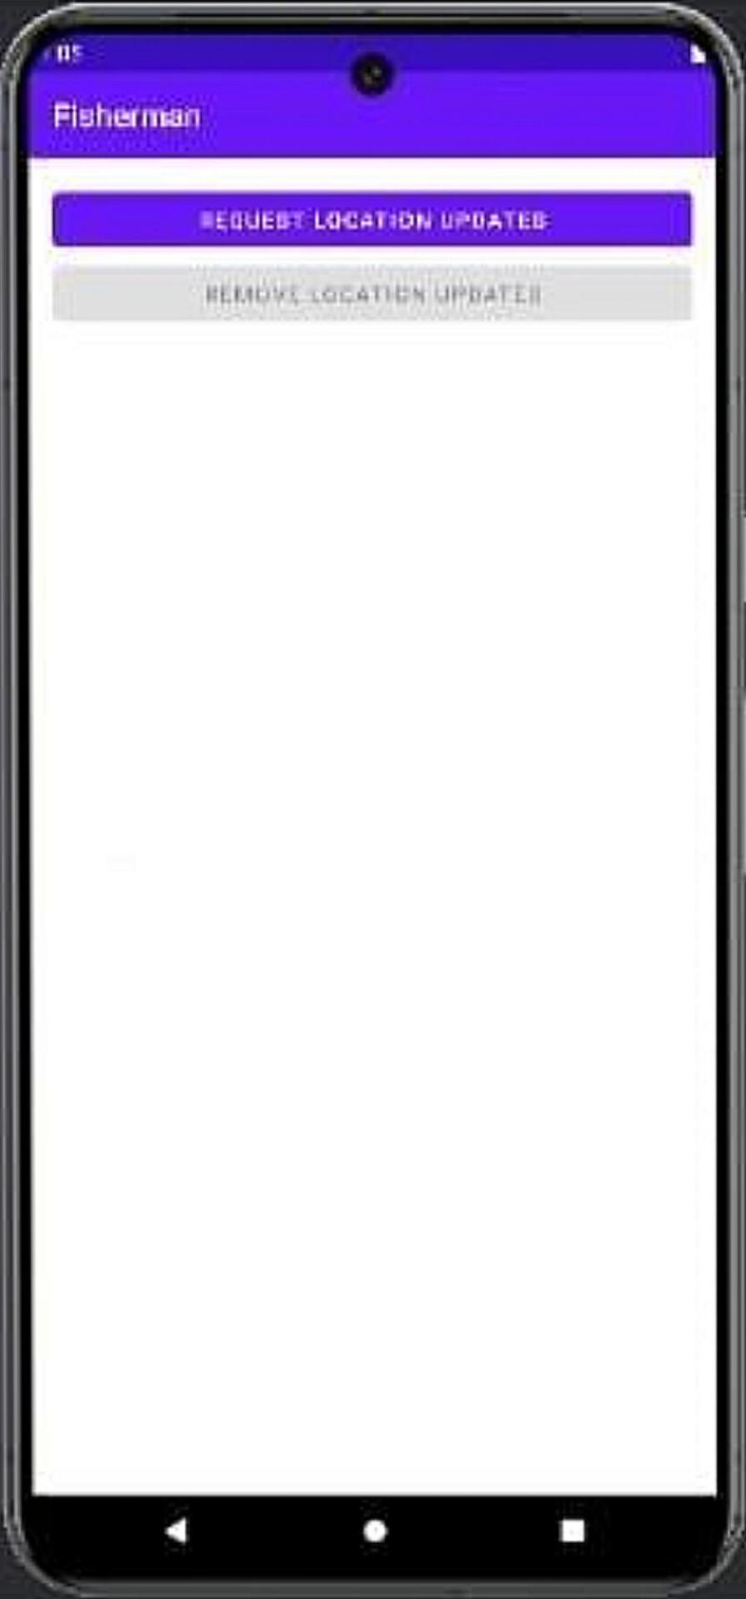
Result
Location Update:
Fishermen Login page:

Slide 12
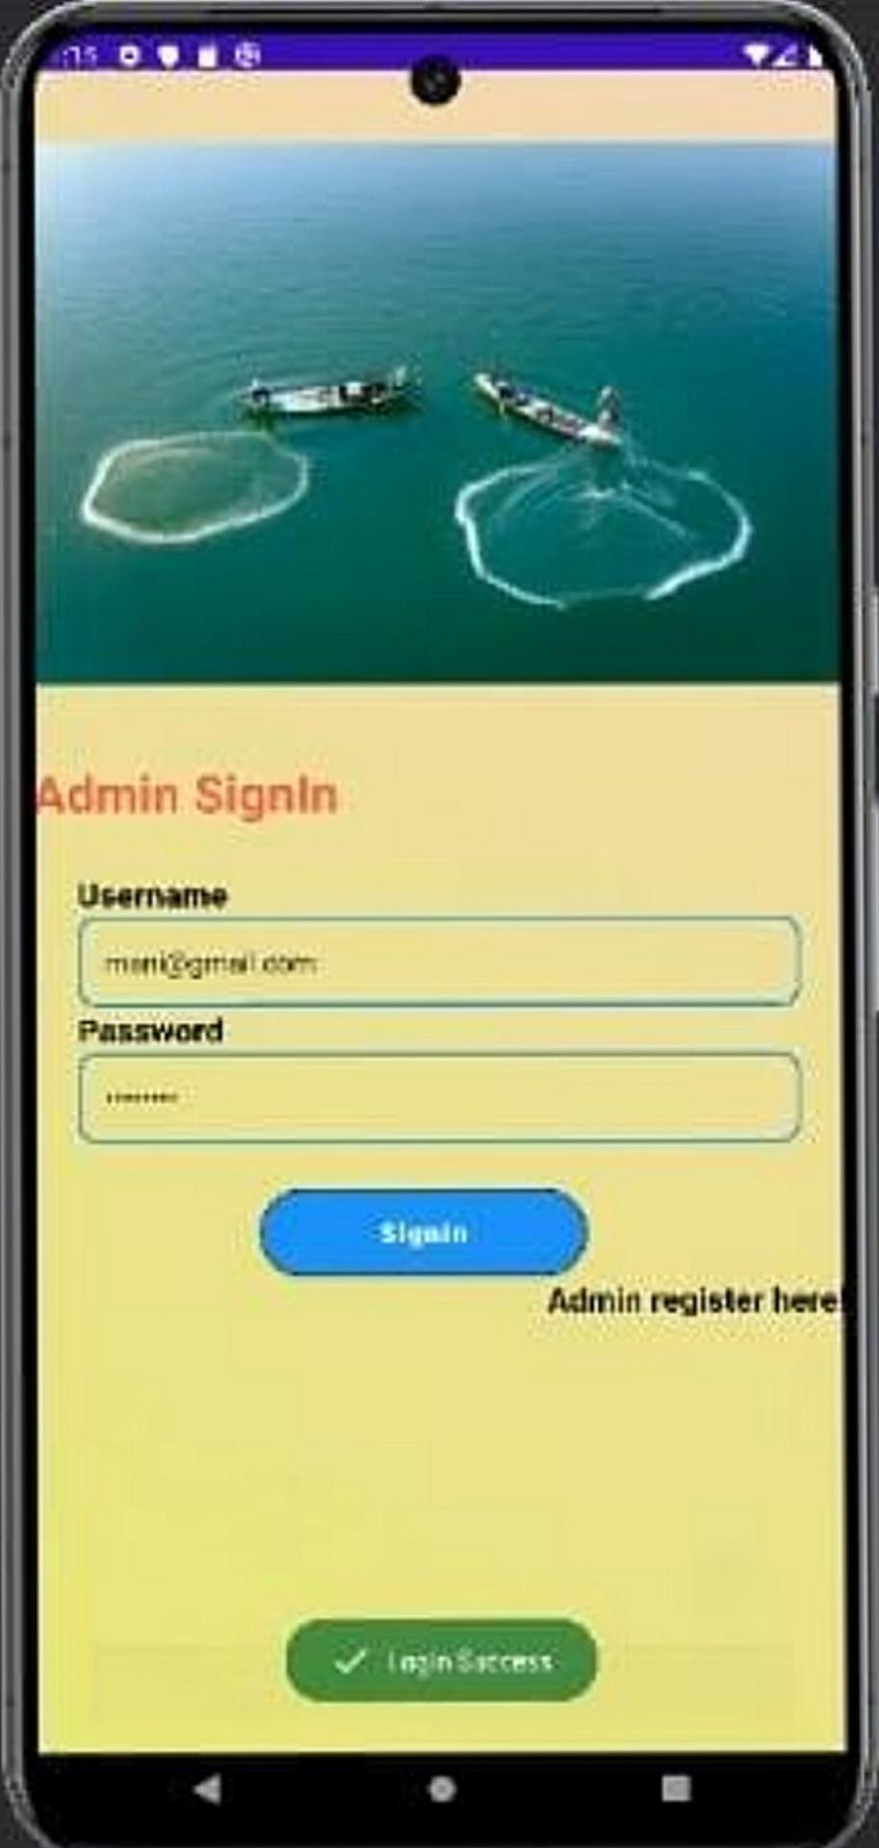
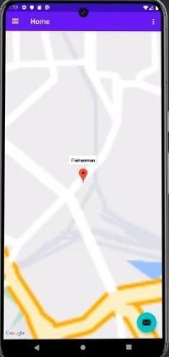
Rescue team Login page:
Location Information:

Slide 13
References
Kesavan TK and Lakshmi K, “GSM-Based Smart Marine Tracking System for Location Monitoring and Emergency Protection”, 2022.
Tharwin Kumar R, “Fisherman Border System Based on IOT Fisherman Border Alert System Based on IOT”, vol. 1, pp. 37-44, 2022.
Thomas T and Mary M, "A WSN-based maritime border alert system to protect fishermen", Multidisciplinary Journal for Applied Research in Engineering and Technology., vol. 1, 2021.
Vivek Ganesh and Karthikaa Raja, “Web-GIS and Mobile-Based Application for a Safe Ocean for Fishers”, vol. 55, pp.50-55, 2021.

